Slide 1

FoodSaver
Mohit Lamba
Harshal Raikwar

Slide 2

Problem Statement
Don’t waste food!!!
Around 1.3 Billion tons of food gets waste annually. About 6% of global greenhouse gas emissions is produced due to wastage of food. This cause global warming, harm environment, wastage of food (which can be feed to needs), wastage of resources, and wastage of money. FoodSaver is a web application that keep track of the food in your house, or restaurant and keep warning you to use the product before it got expire and got waste.

Slide 3

Solution Overview
Provide a platform for everyone to keep track of the food items.
Creates a list of edible items present.
Avoiding wastage of food.
Get recipe of various dishes.
Easy to keep track.
Easy for User to handle products.

Slide 4

Impact
Reduces green house emission.
Easy to keep track of the food.
Save money wasted on food.
Saves resources use for producing food.
Save food.

Slide 5
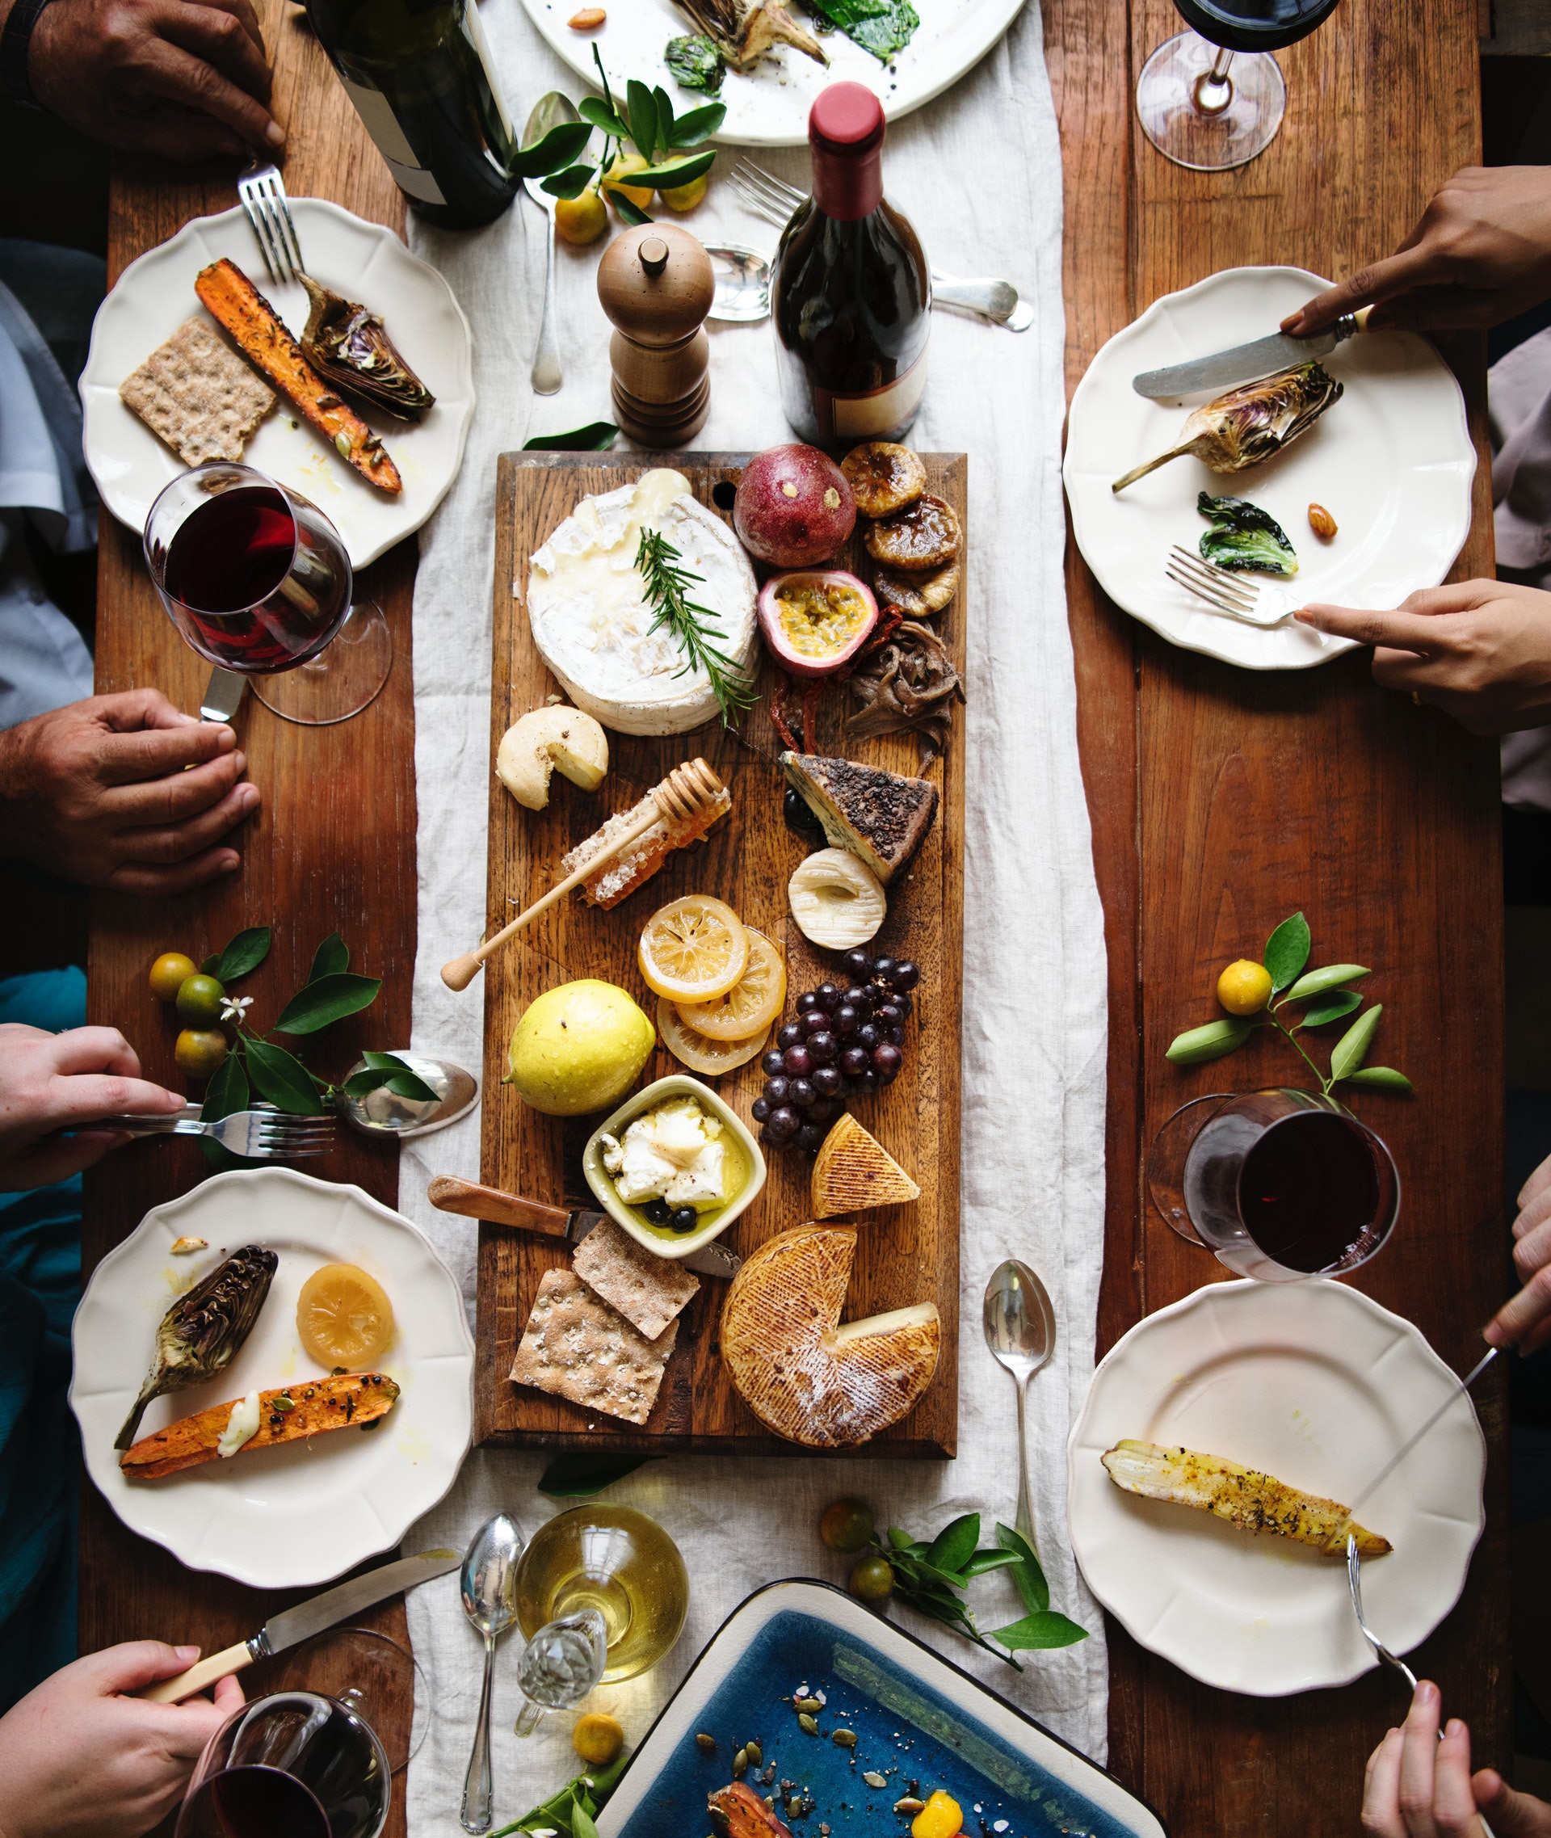




Features
Easy to use
Saves Money
Easy steps to be followed for keeping track of food present.
Saves a lot of money that is wasted while wasting food
Save Earth
Save Resources
Easy steps to be followed for keeping track of food present.
Saves resources wasted on producing food, that is going to be waste

Slide 6
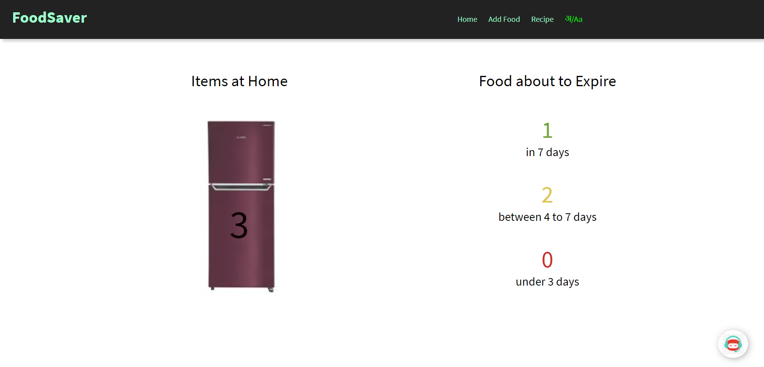
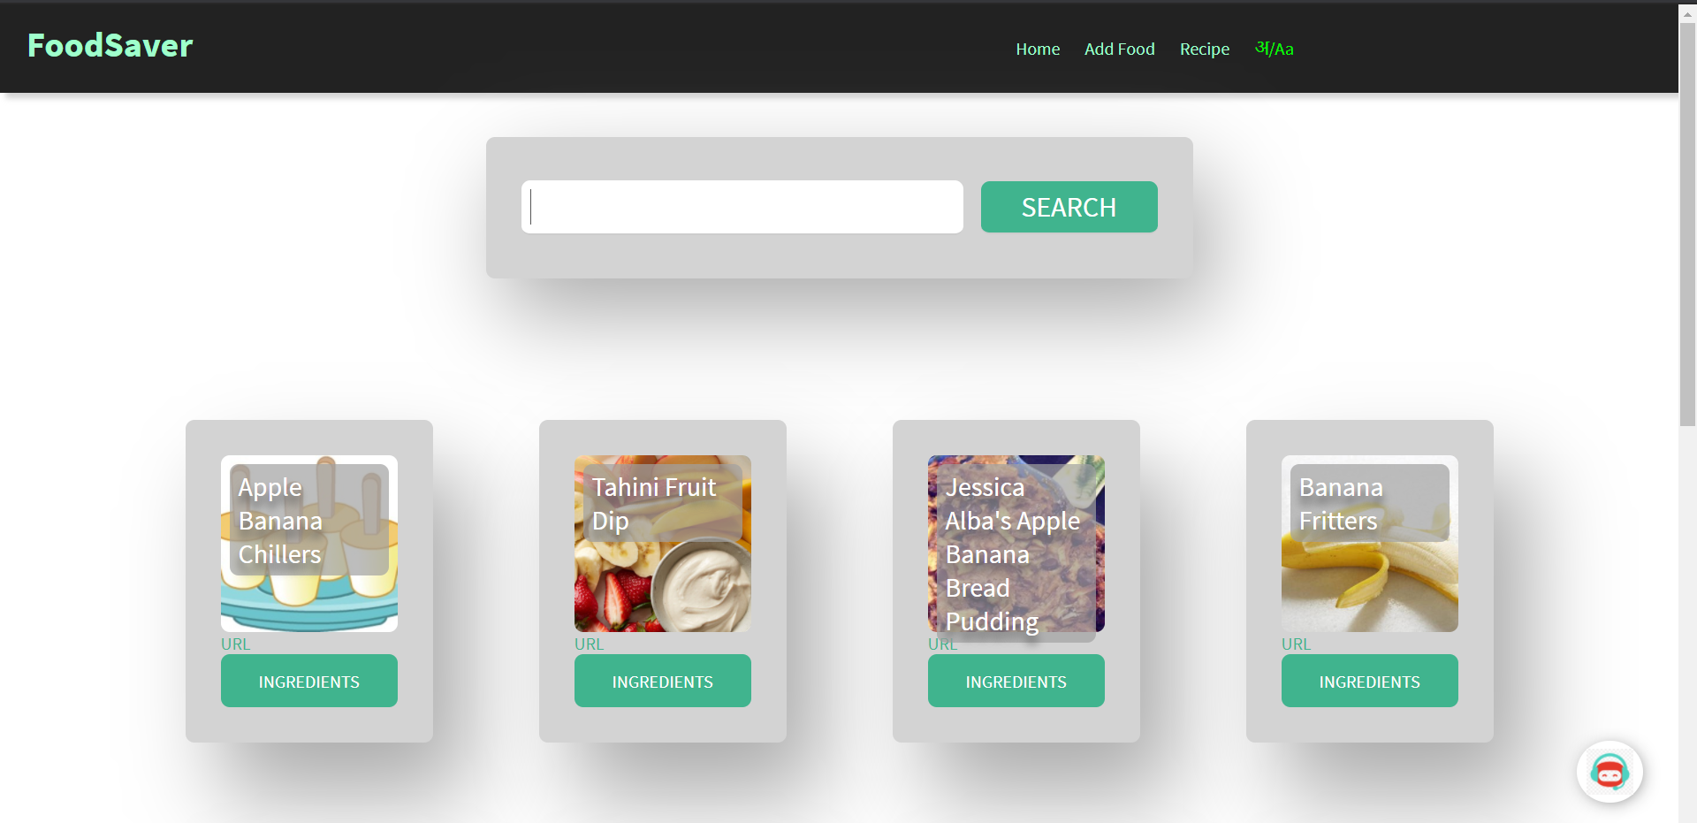
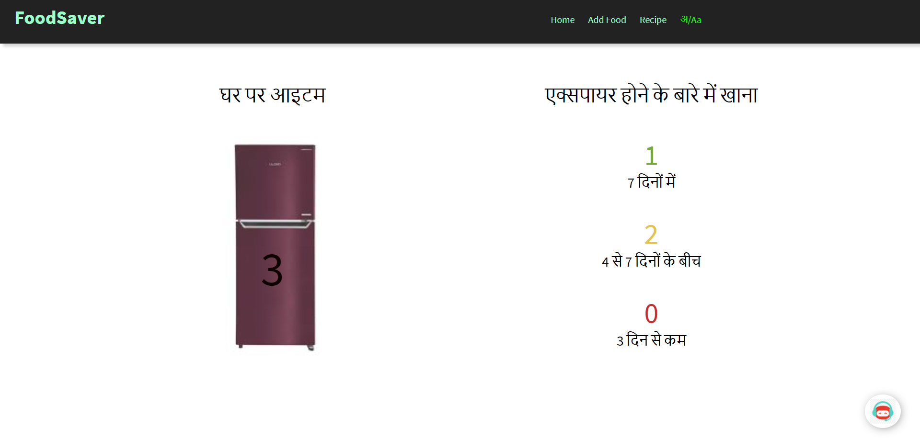
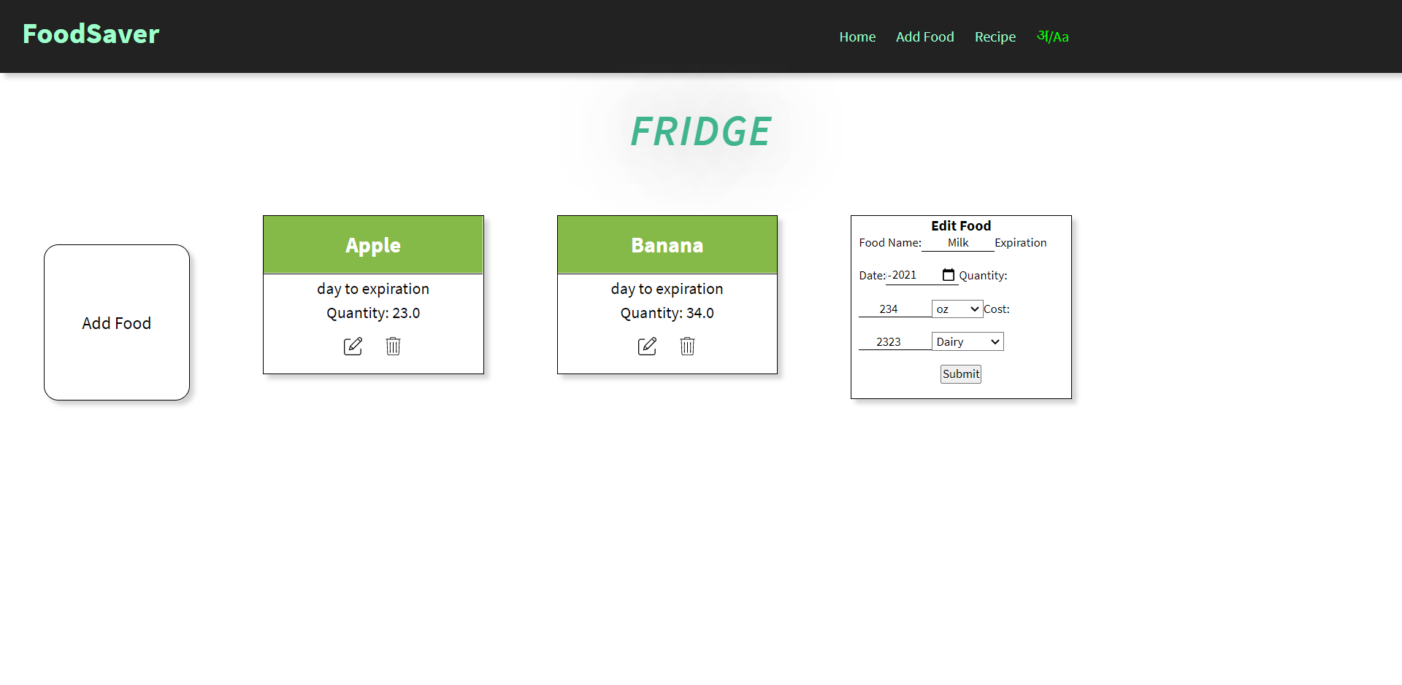
Gallery

Slide 7

Thank You

